Slide 1

Smart farming system

Slide 2


Team Members
Stephanie Perea
Sandia National Laboratories Retiree
Full-time Student

Slide 3
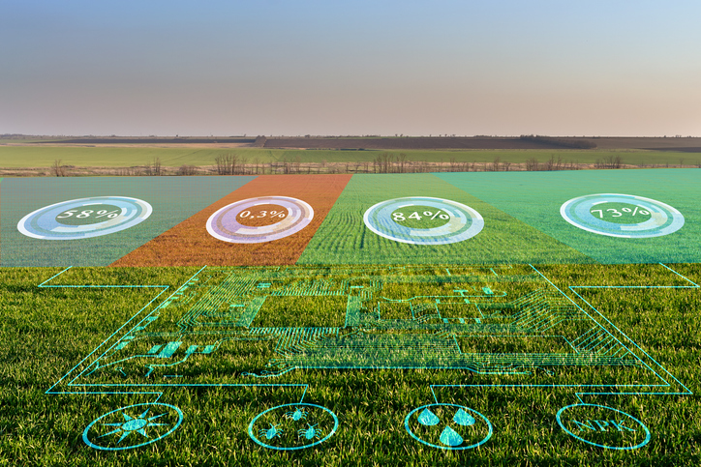
What is a Smart Farming System (SFS)
An SFS provides an array of
resources for real-time
environmental stats
& physical security

Slide 4
The purpose
of this project came about because of my
real-life experiences during
New Mexico’s
1st hemp farming season in 2019

Slide 5
Hemp legalization occurred under the 2019 Farm Bill in 2018
USDA as not able to provide guidance to assist farmers until March 22, 2021.
Problem #1
Pest Control
A lack of pest control guidance impacted the first 2 grow seasons
Caused many hemp crops to fail because of pest infestation
Many farms going organic
Pesticide problem is still needing to be addressed

Slide 6
Smart Farming System Pest Control Solution #1 Ultrasonic sensor proving to be a solution to the pest problem by emitting 40 kHz pulses that pests don’t like

Slide 7
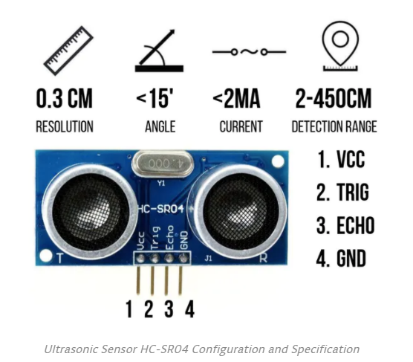
Pest Control
Environmentally Friendly
Solar Powerd with
Rechargable Battery
Prototype Pulse output up to 26 feet away
WiFi
Cost Effective
Wireless
Cloud Computing
Bluetooth

Slide 8
Problem #2
Physical Security
Theft causes loss in yield
Creates legal issues for farmers due to licensing requirements
Legal responsibility to maintain control of all hemp produced.
Solution #2
Ultrasonic component also serves as a security system.

Slide 9
Security System
Reduces Carbon Footprint
Prototype Pulse Return
Distance 13 feet
Maximum direct line sight
Real-time Text Notification when system detects intruder

Slide 10
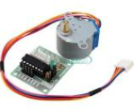
The Smart Farming System utilizes a Step Motor to provide wide sweep of ultrasonic pulses across field
5VDC
Class B insulation
Internal wiring to sustain temperatures of up to 130 degrees Celsius
With a Ambient temperature of 40 Celsius, the stepper motor has a temperature rise allowance of 90 Celsius.
Stepper motors can run continuously at these temperatures.

Slide 11
Problem #3
Controlling Hemp Pollination
Pollination triggers seed propagation
Decreases trichome production
Trichomes are the mechanism by which hemp produces cannabinoids, such as cannabidiol (CBD)
Majority of New Mexican farmers invested in high CBD hemp strains to produce, manufacture and sell high quality CBD hemp oil not seed generation

Slide 12
Solution #3
Pollin Monitoring with a Grove Particulate Sensor
Capable of detecting particulates as small as 1um in size
Hemp pollen measures approximately 25um and thus is not difficult to detect.
The pollination season begins about 4 to 5 weeks after females’ flower which will trigger the Smart Farming System
System will prompt farmer to seek out and destroy male plants and hermaphrodites in the field
Note: Majority of seed planted in New Mexico was/is feminized and guaranteed to produce approximately 97% female plants per pound. This sometimes triggers female plants to morph into hermaphrodites to secure future generations.

Slide 13
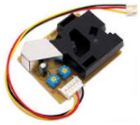
Solution #3
Pollen Detection System
Monitors pollen for optimal trichome and cannabinoid yield
Pollination control to prevent seed propagation
Geo mapping for rapid location of high pollen areas
Connected to a solar power unit for 24/7 wireless rural monitoring
Cloud Computing Capabilities - remotely connectivity via WiFi and Blue tooth
-

Slide 14
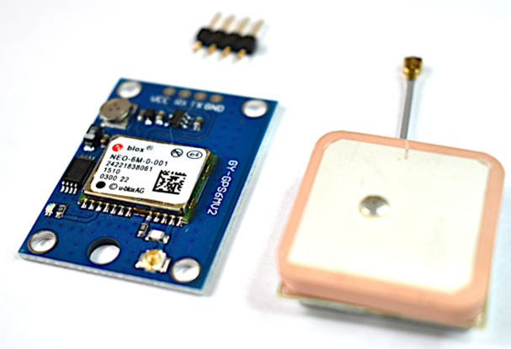
The Smart Farming System also houses a NEO-6M GPS Module to assist in locating pollen generators in the crop
Module Description:
Power Supply: 3V-5V
EEPROM
LED Indicator
Backup battery
Baud Rate: 9600
Module Dimensions: 23mm x 30mm
Antenna Dimensions: 25mm x 25mm
Antenna Cable Length: 50mm
Arduino UART Compatible

Slide 15
Problem #3 Weather Grow season:
Dry and hot summer days led to improper soil moisture management
Caused many hemp plants to fall into a stressed state
A stressed state causes a spike in tetrahydrocannabinol (THC) production
Caused hemp to surpass the 0.3% THC legal threshold
Led to the destruction of many New Mexico hemp crops.
Excess moisture also forms
Fungus
Mold
Macro-organisms
Hemp biomass rendering it useless for oil production

Slide 16
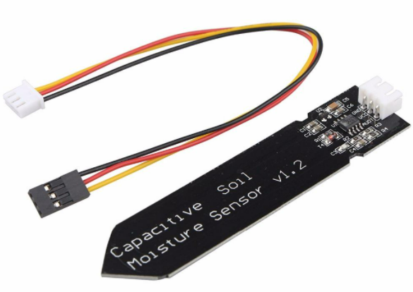
Solution #2 The Smart Farming System utilizes a soil sensor to monitor moisture levels using capacitance rather than resistance to determine the water content of soil. The module uses a TL555I CMOS timer to create a 1.5MHz clock A peak voltage detector converts the waveform from the TL555I into a DC voltage that can be read by the ADC input of a microcontroller. When the probe is exposed to moisture, it affects the capacitance of the circuit which in turn affects the peak amplitude of the signal and therefore the DC voltage output that is being monitored by the MCU. Higher moisture = lower DC voltage output.

Slide 17
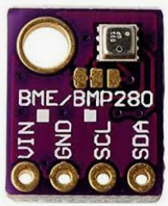
The BME280 Component can measure:
Relative humidity from 0 to 100% with ±3% accuracy
Barometric pressure from 300Pa to 1100 hPa with ±1 hPa absolute accuracy
Temperature from -40°C to 85°C with ±1.0°C accuracy.
The pressure measurements are so precise (low altitude noise of 0.25m), can be used as an altimeter with ±1 meter accuracy.

Slide 18
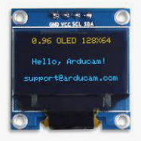
OLED Display Features
Diagonal Screen Size：0.96"
Number of Pixels：128 x 64
Color Depth：Monochrome
Dimension：27.8 x27.3x 4.3 mm
Working Voltage: 3.3~ 5V DC
Power: 0.06W Max
Viewing Angle: >160 Degree
Duty：1/32
Brightness ( cd/m2)：150 (Typ) @ 5V
Interface： I2C

Slide 19
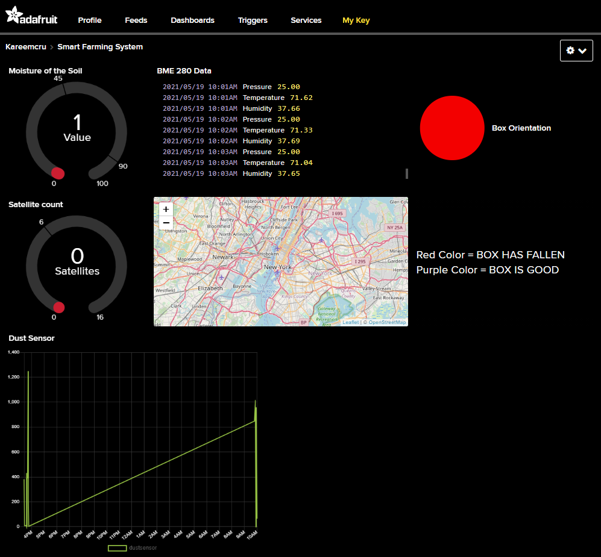
The Smart Farming System houses its own weather station The system is equipped with a monochrome display for real time weather data out in the field. Data can also be accessed from anywhere in the world via Adafruit.io cloud computing.

Slide 20
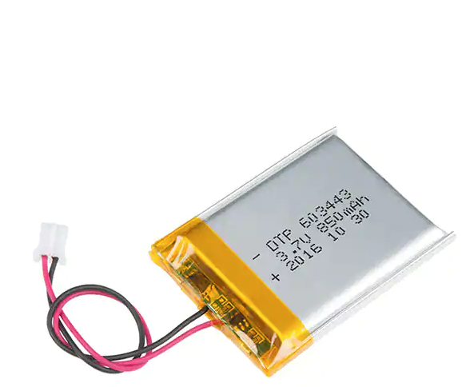
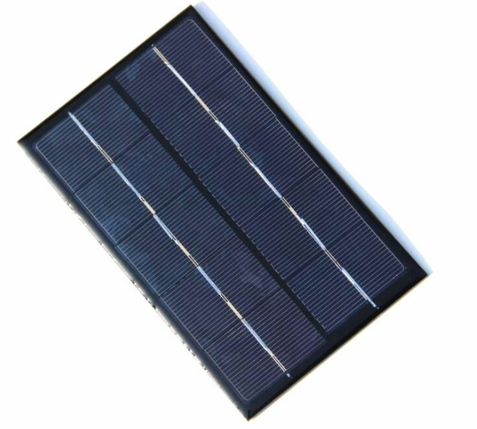
The Smart Farming System is powered via Rechargeable Battery and a Solar Cell
Polymer Li-ion Rechargeable Battery Model：DTP603443 Specification：3.7V/850mAh
1X 6V 1W 110x60mm Micro Mini Power Small Polycrystalline Solar Cell Panel Module

Slide 21
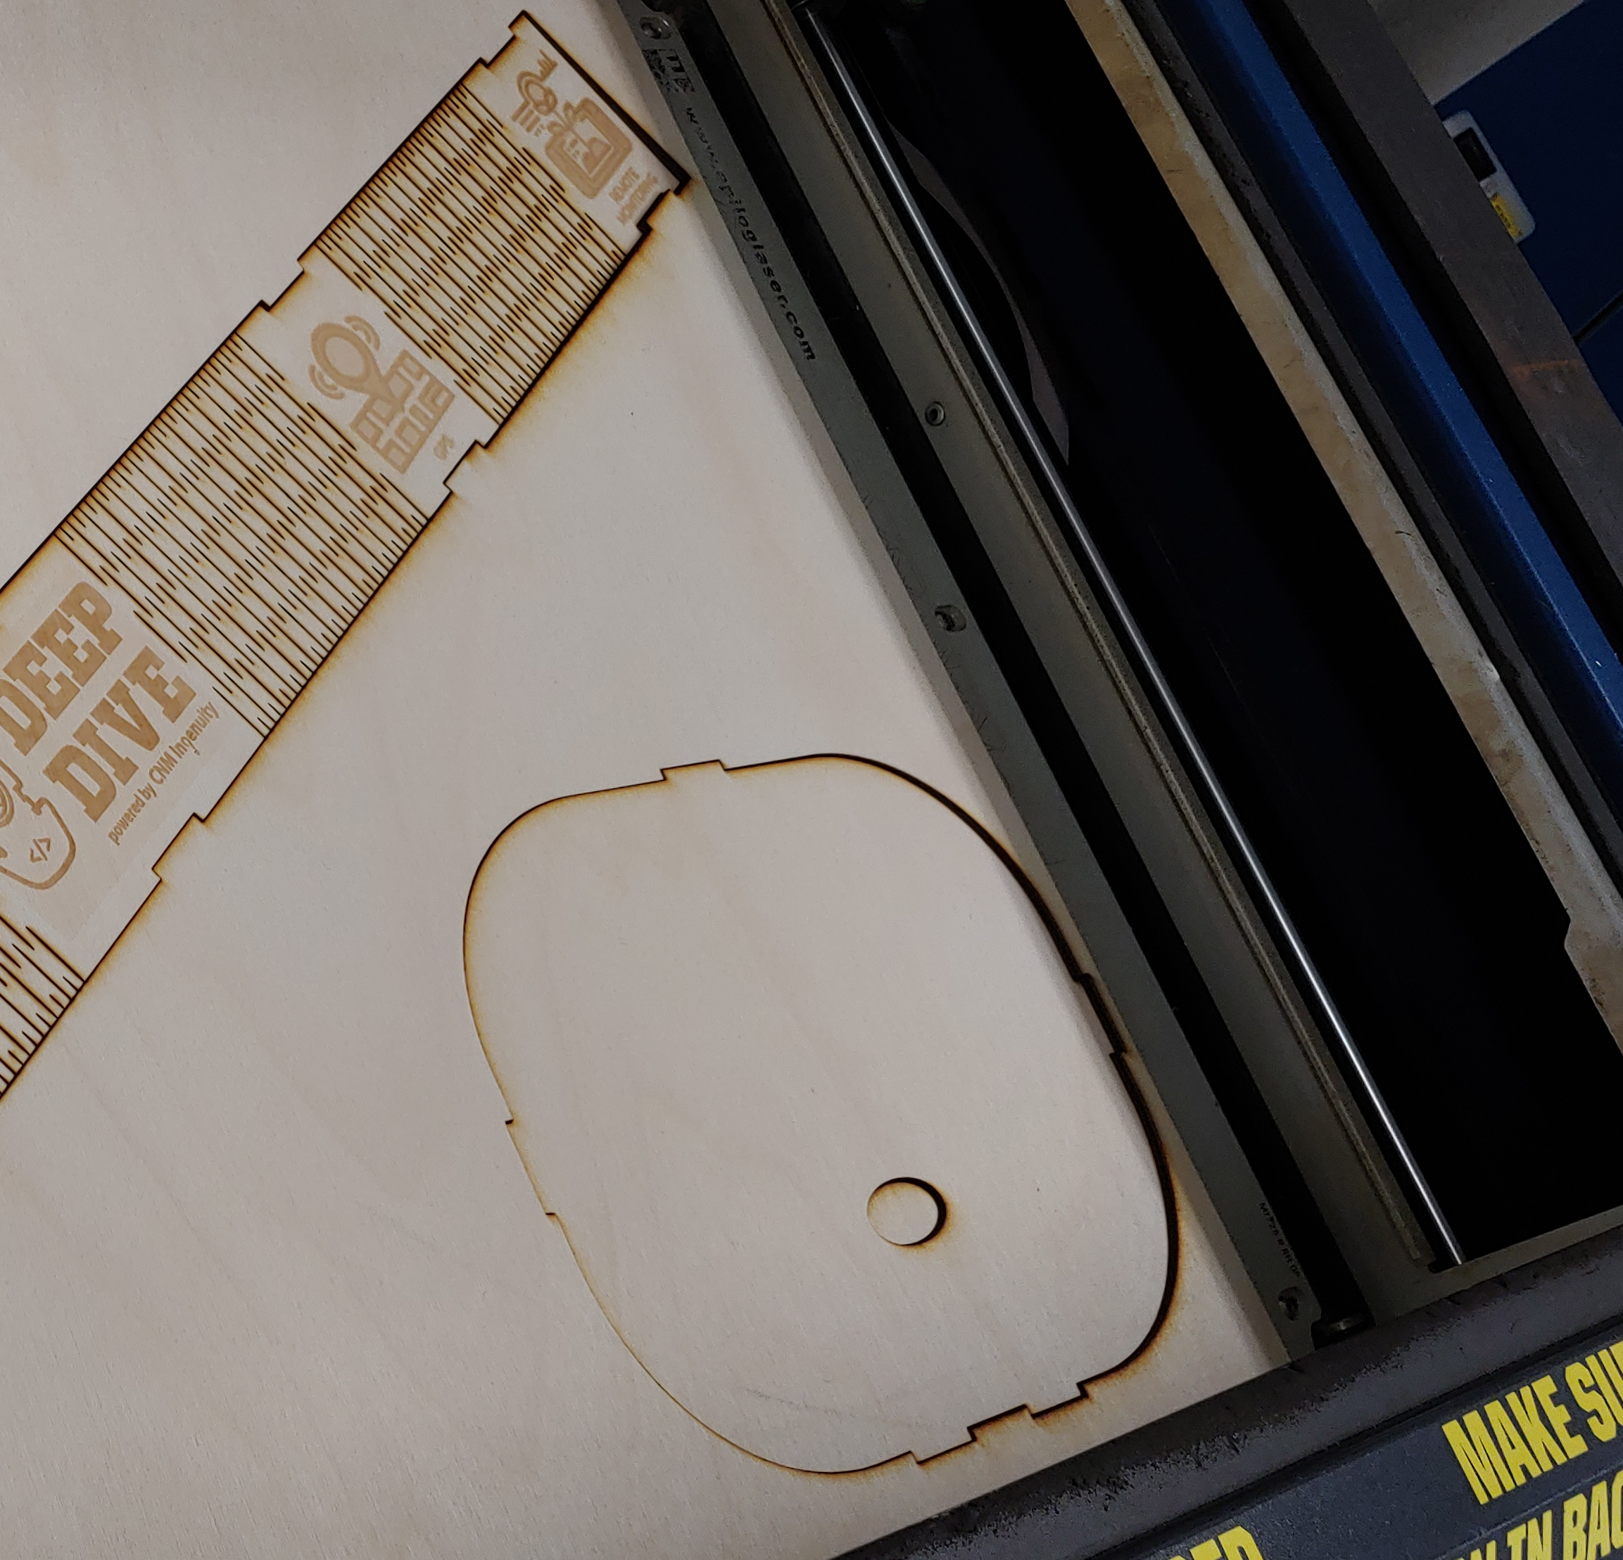
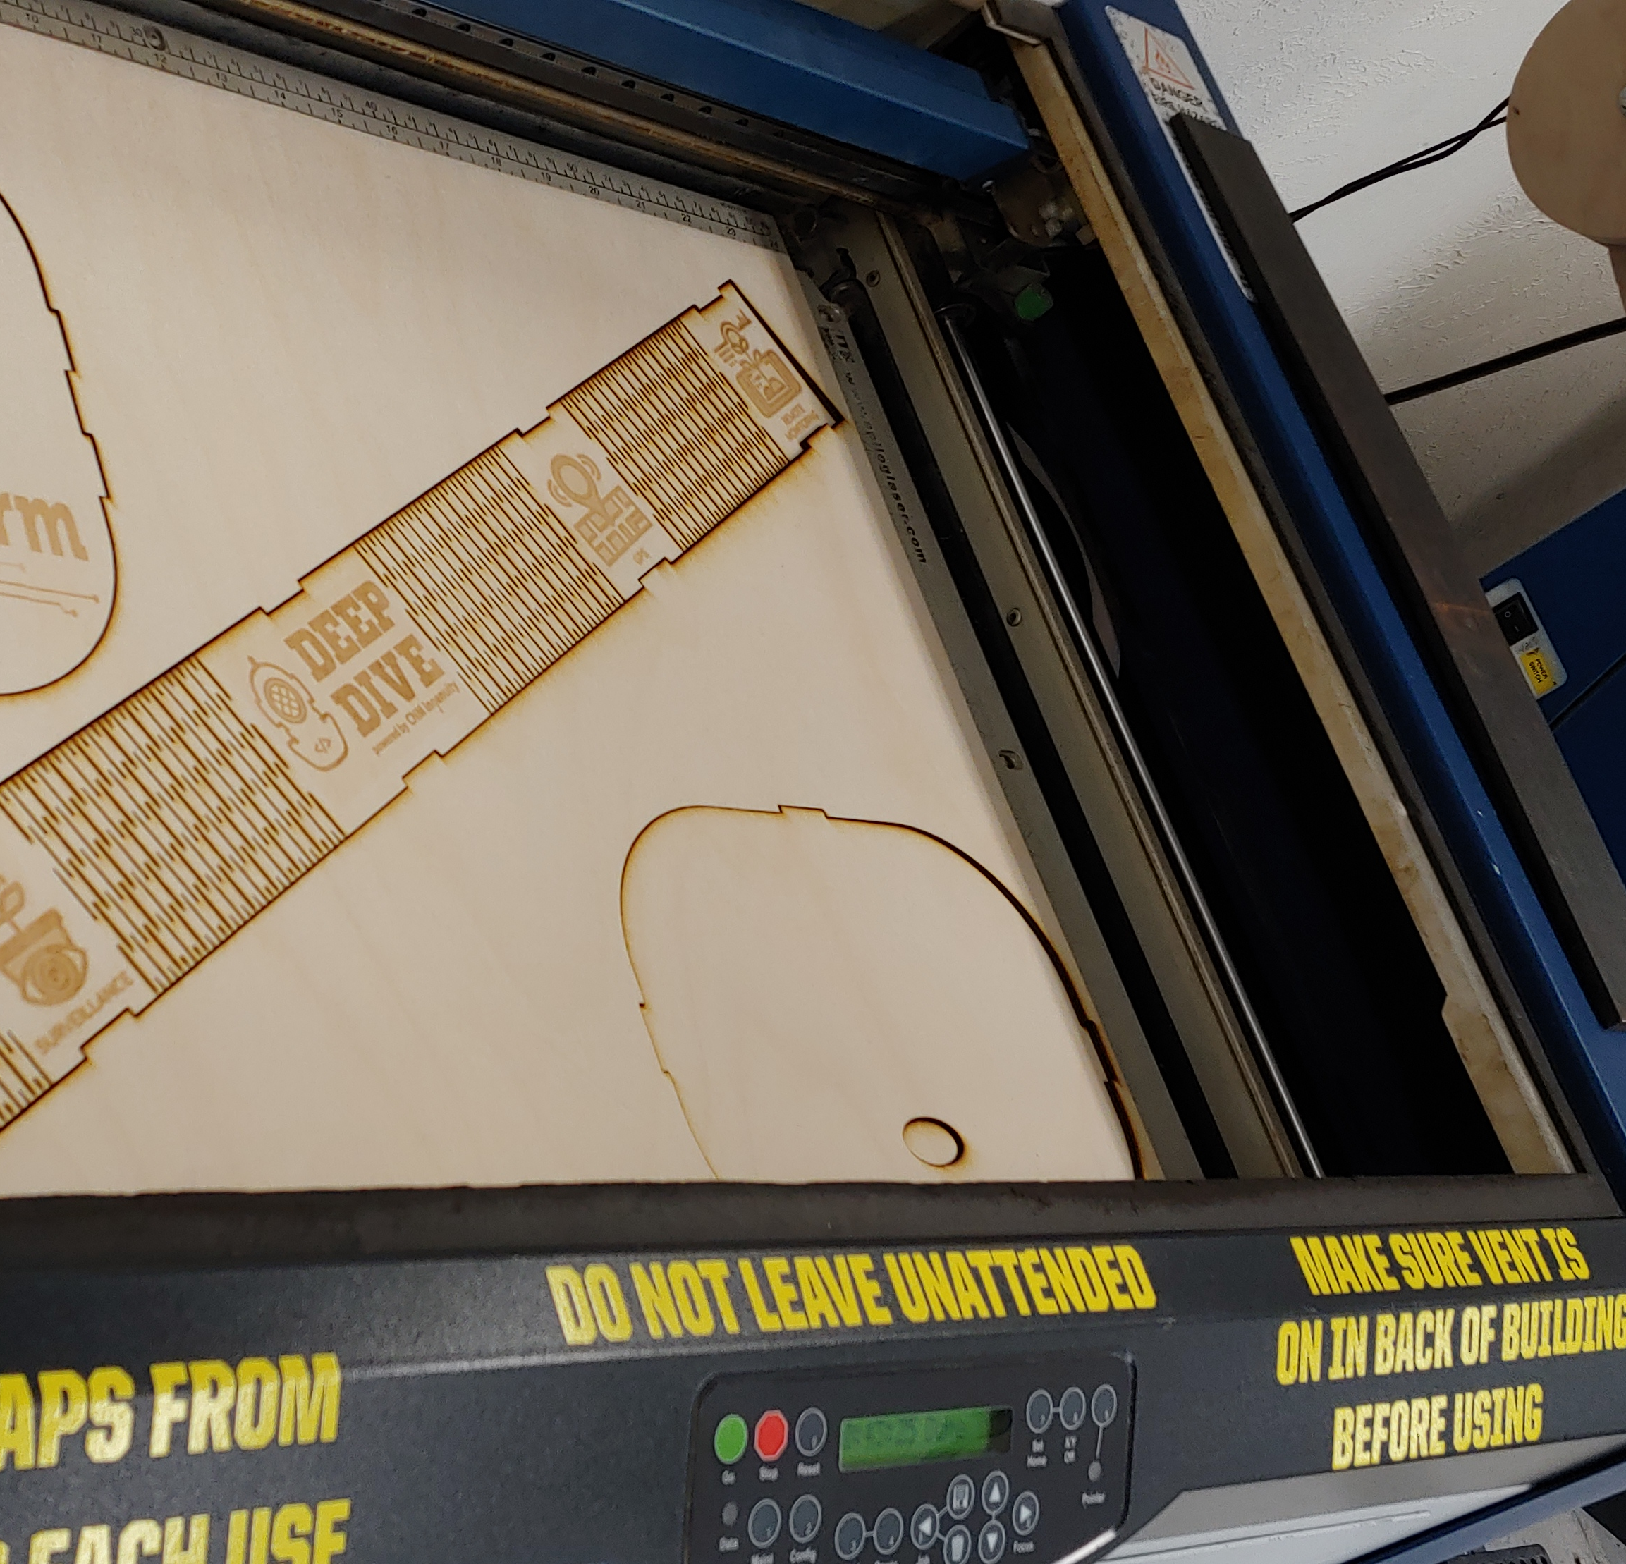
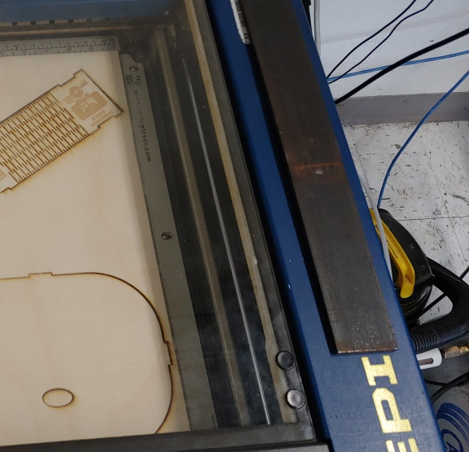
laser cut enclosure

Slide 22
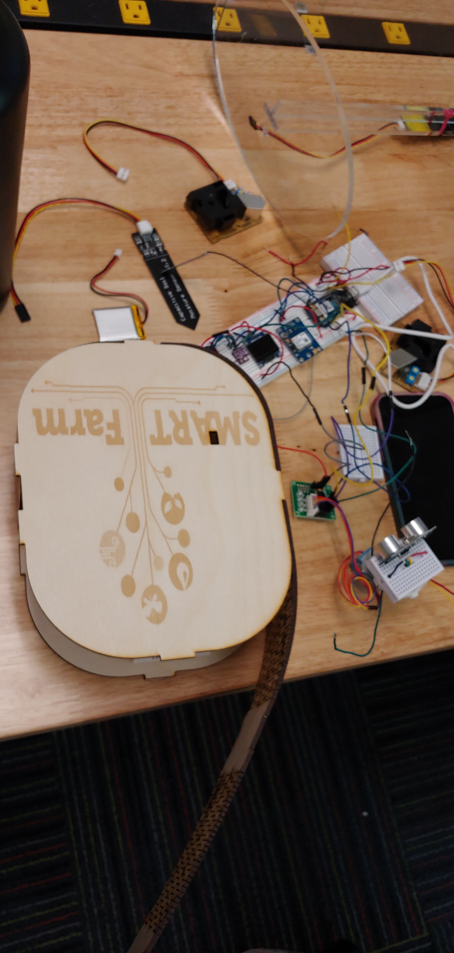
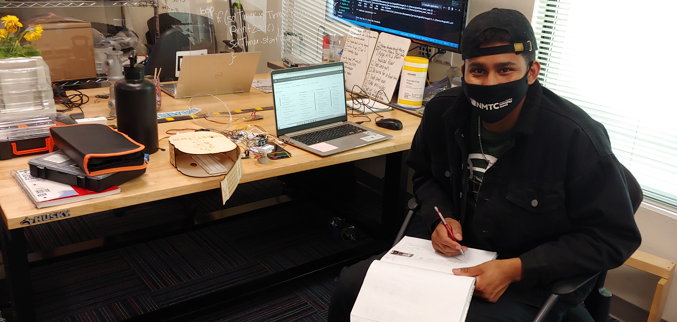
Kareem hard at work

Slide 23
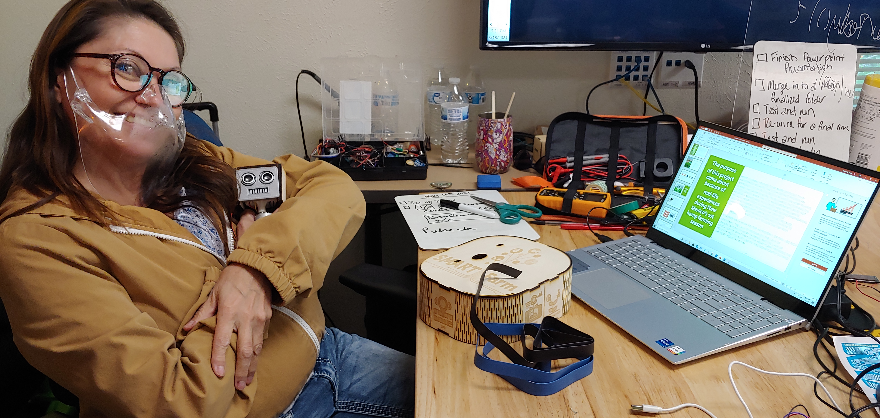

Slide 24
VIDEO DEMO
ASPECTS OF PRODUCT FUNCTIONALITY
DEMONSTRATION OF WORKING PROTOTYPE
FILM QUALITY HIGH
PHOTO QUALITY HIGH
ZOOM TO HIGHLIGHT COMPONENTS
NARRIATION AND SUBTITLES USED TO EMPHASIZE POINTS

Slide 25
Developmental challenges
Problem solving
Teaming solutions

Slide 26
Final project summary

Slide 27
Future goals for project
Camera
Random Frequency output with 2 Piezoelectric Elements

Slide 28


Stephanie Perea sperea10@cnm.edu

